Slide 1

About the System:
CIFOR-ICRAF Travel Authorization System
Travel Authorization System is a tool used by employees to obtain approval before undertaking official travel. This system ensures that all work-related travel is pre-approved, supports transparency, and facilitates more efficient travel management within the organization.
CIFOR-ICRAF

Slide 2
1
Step
Implementation Dashboard
1
2
3
ETL (Extract, Transform, Load) Data
Development and Implementation Dashboard
Design Dashboard
CIFOR-ICRAF

Slide 3
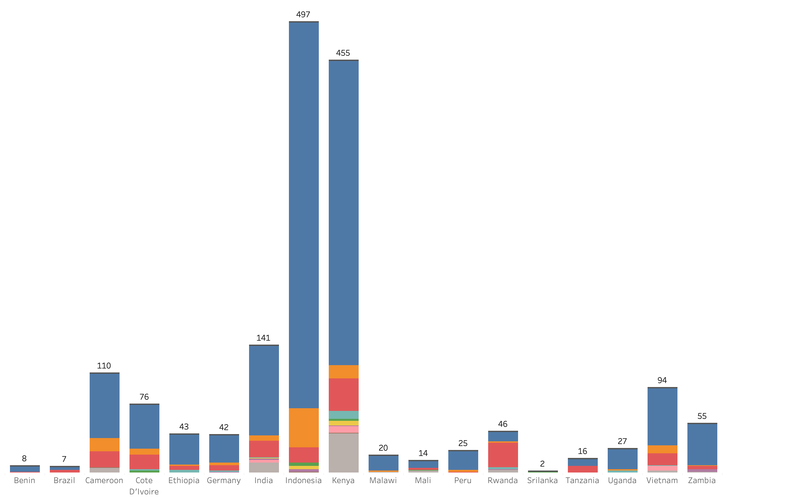
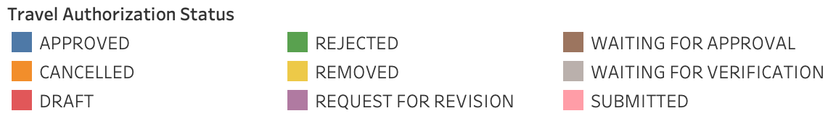
2
Total Countries with the Most Travel Requests by Authorization Status
This dashboard shows the top countries with the highest number of travel permit requests. There are 18 countries listed, with Indonesia as the country with the most requests 497.
The dashboard also shows the status of each travel authorization request, such as approved, cancelled, draft, denied, deleted, revision request, submitted, pending approval etc.
This information can be used by travel administrators to track the progress of travel authorization requests and identify bottlenecks in the process.

Slide 4
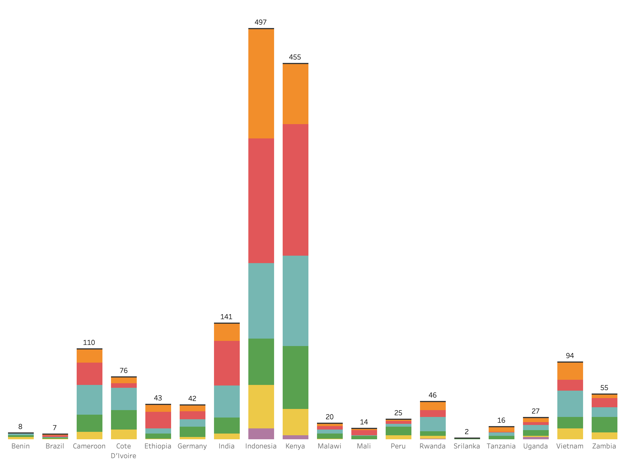

3
Peak Travel Season by Month and Country
This dashboard is designed to identify crucial peak travel seasons. By understanding the months and countries with the highest travel requests, the company can allocate appropriate budgets, manage work capacity, and ensure all travel requirements are met.
The chart illustrates the distribution of travel requests by country and month, with the highest peak observed in February 2024, recording a total of 479 travel requests. The country with the most travel requests is Kenya, with 159 requests in February.
This information allows the company to anticipate activity surges, maintain smooth operations, and provide additional insights for regional management regarding the countries with the highest travel activity during peak seasons.

Slide 5
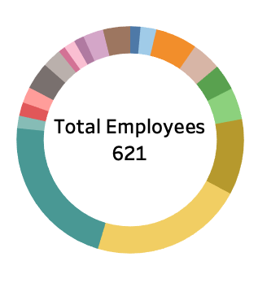
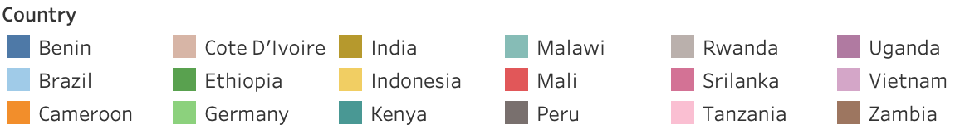
4
Analysis of Number of Workers per Country
This dashboard provides deep insights into the distribution of employees involved in travel approvals by country. The data shows significant variation in the number of employees handling approvals, with Kenya having the highest number at 137 employees. Conversely Sri Lanka has the fewest employees involved, with only 6.
Understanding this distribution is crucial for identifying workload and approval capacity in each region. With this data, the company can allocate human resources more efficiently, ensuring that no employee is overburdened and that each country has enough personnel to handle travel requests. Additionally, this information is valuable for planning training and capacity development in specific regions, thereby enhancing operational efficiency and responsiveness in international travel management.

Slide 6
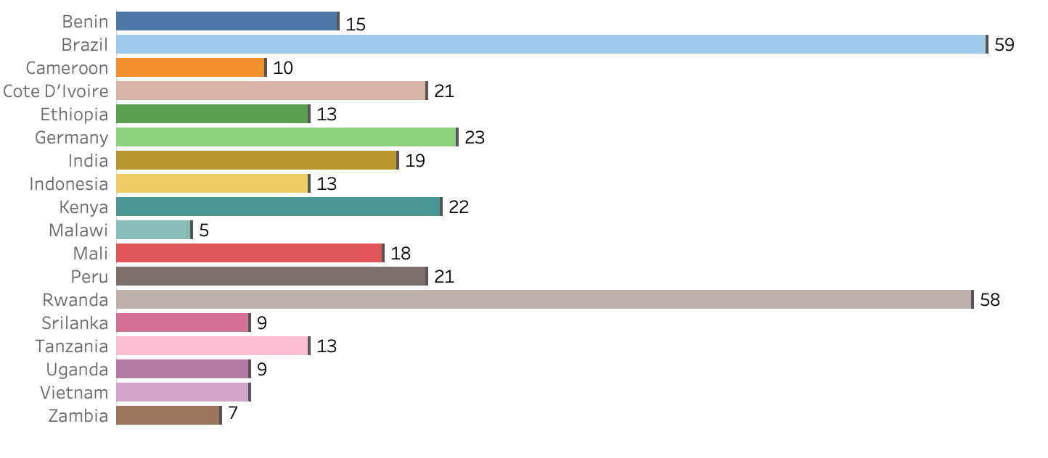
5
This dashboard provides deep insights into the average approval times for travel visas across various diverse countries. The data highlights Indonesia as particularly notable with an average approval time of just 13 days, encompassing 426 approved. In contrast, Brazil requires the longest time, at 59 days, to approve only 4.
The information presented is invaluable as it enables companies to identify specific patterns or challenges within the approval processes in each country. With this understanding, businesses can allocate resources to optimize the approval process, reduce time spent, and enhance responsiveness in international travel management. These measures not only improve overall operational efficiency but also minimize disruptions to carefully planned business travel arrangements.
Average Days Authorization Approval for Travel

Slide 7
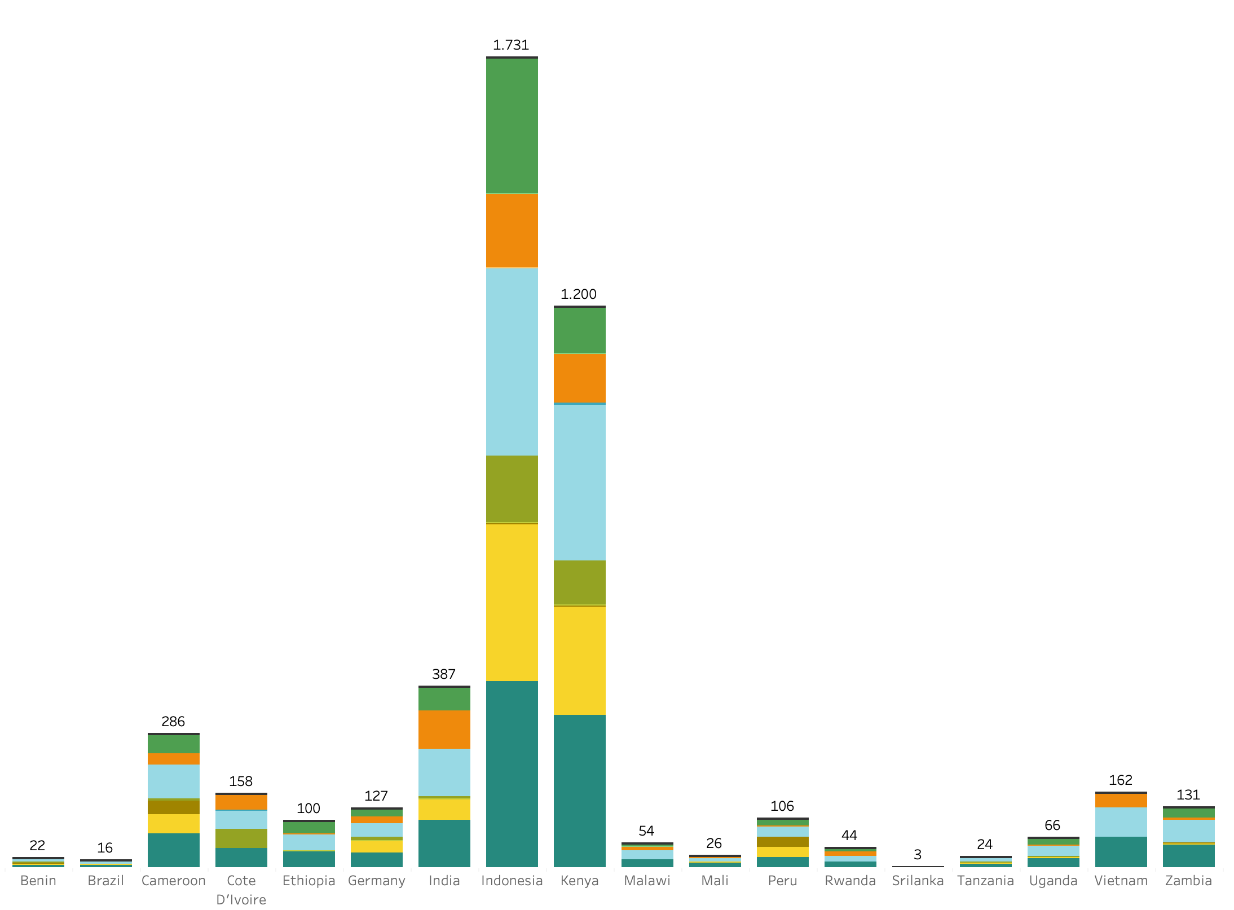
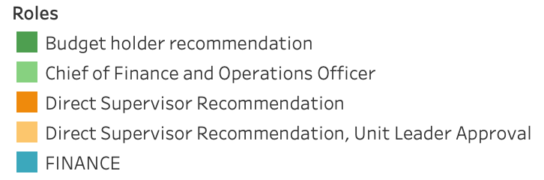
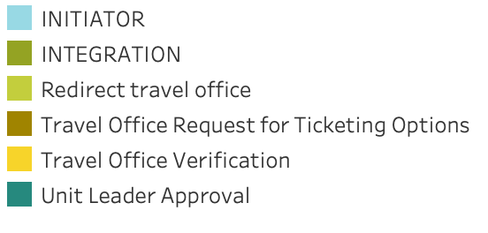
6
Position Analysis of the Approving Employee
This dashboard provides insight into employee roles in travel approvals in different countries. The data shows significant variation, for “Unit Leader Approval” in Indonesia has the highest number of approvals with 397, while Brazil has the lowest number of approvals with only 4. The “INITIATOR” role is most visible in Indonesia with 401 approvals, while Sri Lanka has the highest number of approvals lowest with just 1.
This information is important for human resources management, helping to identify roles that require more support or that have more efficient approval processes. It is also useful for planning fairer and more efficient travel policies, as well as ensuring optimal allocation of human resources, reducing excessive workload and increasing the efficiency of travel approval processes in organizations.

Slide 8

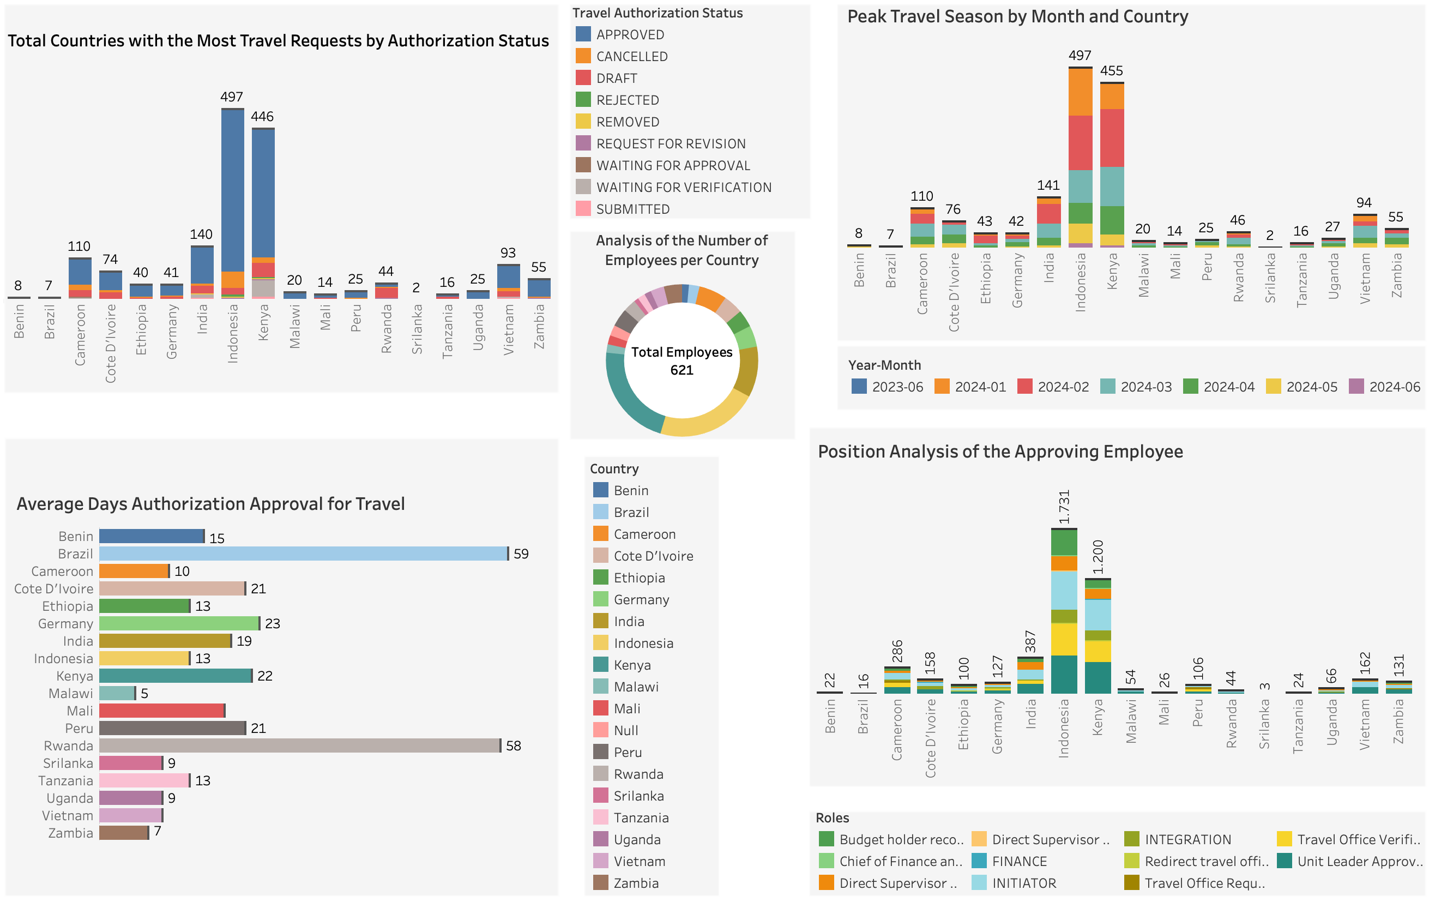
7
Conclusion
The Analysis carried out shows that Indonesia is the country with the highest demand for travel authorization in CIFOR-ICRAF, while Indonesia and Kenya also have significant demand. It was found that February 2024 was the month with the highest demand, especially from Indonesia and Kenya. The average travel authorization approval time varies between countries, with Indonesia having the fastest approval time and Brazil taking the longest. The distribution of employees involved in the approval process also shows variations, with Indonesia having the largest number and Sri Lanka the least. The analysis also shows that the role of "Unit Leader Approval" in Indonesia has the highest number of approvals, while Brazil has the lowest number of approvals in the same role.

Slide 9
Digital Transformation Solution
CIFOR-ICRAF Travel Authorization System
8
CIFOR-ICRAF

Slide 10
9
5 Step
Implementation Solution
1
2
3
4
5
Process Digitalization
Data Analysis and Reporting
Training and Development
Policies and Procedures
Monitoring and Evaluation
CIFOR-ICRAF

Slide 11

10
Process Digitalization
Implement an integrated digital system to manage and monitor the entire travel authorization process, from request to final approval.
Using technology such as business process automation to reduce the time required at each stage
Automatic Data Collection Ensures travel data is automatically collected and stored in digital systems for better analysis and reporting.
CIFOR-ICRAF

Slide 12

11
Data Analysis and Reporting
Create a real-time and interactive dashboard to monitor the status of travel requests and approval times.
Data Integration: Integrates data from multiple sources to provide a more comprehensive and in-depth picture of travel trends and approvals.
CIFOR-ICRAF

Slide 13

12
Training and Development
Provide ongoing training for employees on travel policies, use of digital systems, and approval procedures.
Hold workshops and training sessions to share best practices among different countries and departments.
Data-Driven Training Evaluation Using data to illuminate the effectiveness of training programs and adapting them based on feedback and performance results.
CIFOR-ICRAF

Slide 14

13
Policies and Procedures
Regularly review and update travel policies to ensure alignment with the company's operational and strategic needs.
Develop clear standard procedures for travel requests and approvals to increase efficiency and consistency.
CIFOR-ICRAF

Slide 15

14
Monitoring and Evaluation
Conduct regular audits of the travel authorization process to identify areas for improvement.
Use feedback from employees to continuously improve existing systems and processes.
Data-Driven Performance Tracking Implement data-backed key performance indicators (KPIs) to periodically monitor and evaluate the efficiency of the travel approval process.
CIFOR-ICRAF

Slide 16

“The clearest way into the Universe is through a forest wilderness”
John Muir
Thank you, any question?
CIFOR-ICRAF

